Slide 1
Class Compass

Slide 2
Agenda
Introduction
Acknowledgement
Tools & Technology Used
E-R (Entity Relationship) Diagram
Database Diagram
Data Flow Diagram
Use Case Diagram
Screenshots Of Application with Major Flow
Conclusion

Slide 3

Introduction
Class compass

Slide 4
Acknowledgement
This project is About “ CDAC Student Portal ”
Aim is to develop a portal that connects students and the college administration efficiently.
A key feature of this portal is its ability to provide real-time access to academic results traditionally.
we are submitting this work to Advanced Computing Training School (CDAC ACTS).

Slide 5

Submitted to Centre for Development of Advanced Computing
By :
Mr. Bahirat Yash
Mr. Bhosale Sanket
Mr. Takalkar Sagar
Mr. Shrishail Haridas
Mr. Shubham Satpute
Under the guidance of
Mr. Vinu Josy

Slide 6
Tools & Technology Used
Spring Boot
Spring Data JPA
RESTful Web Services
Node JS
Express JS
Spring Web
MySQL
JWT
Git
Spring Security
React JS
HTML & CSS
Material UI

Slide 7
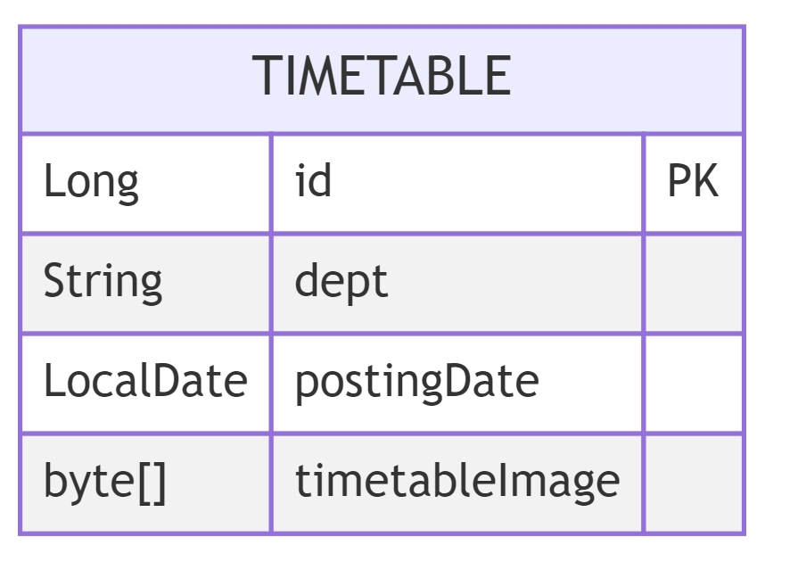
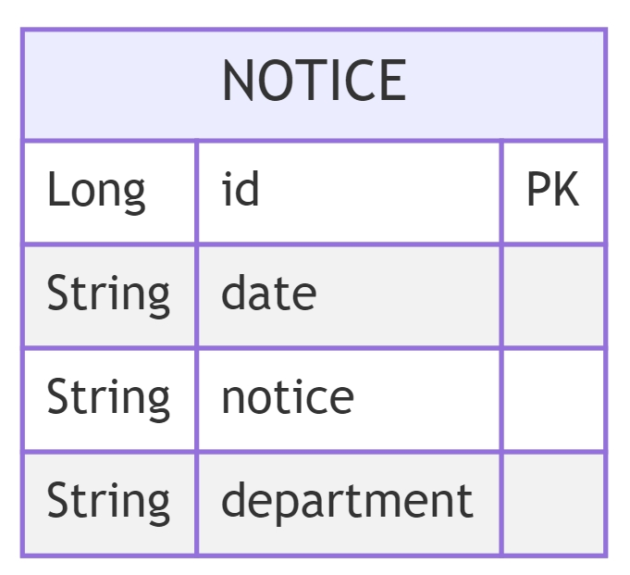
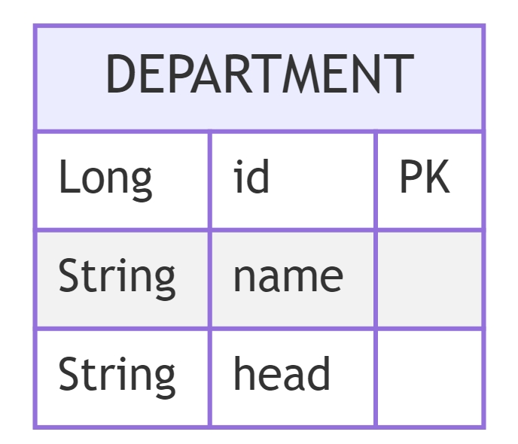
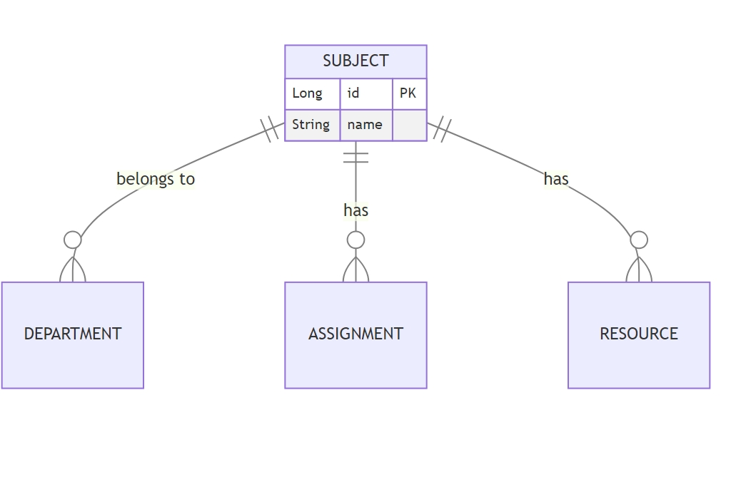
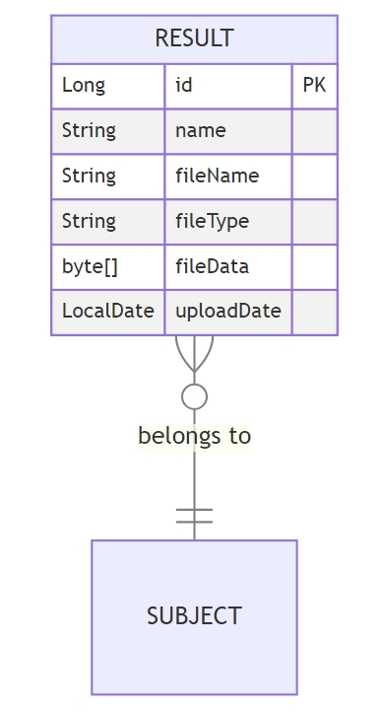
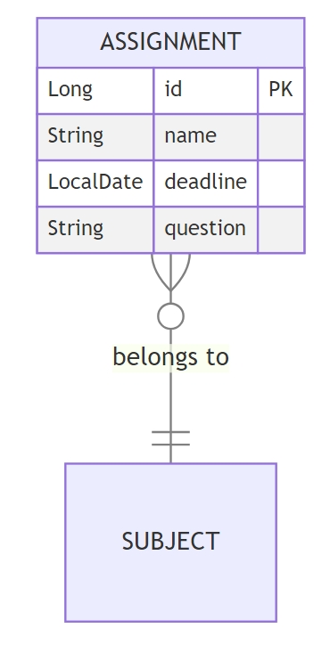
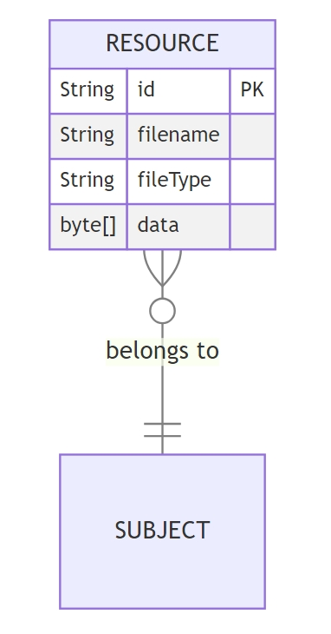
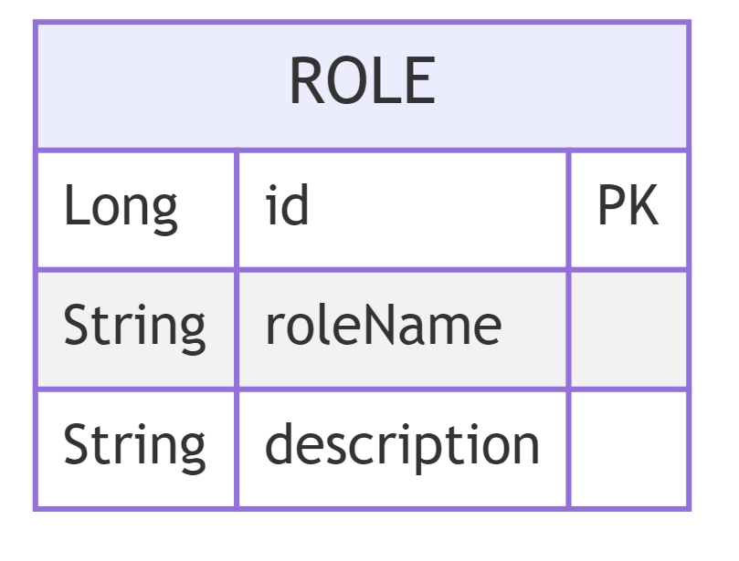
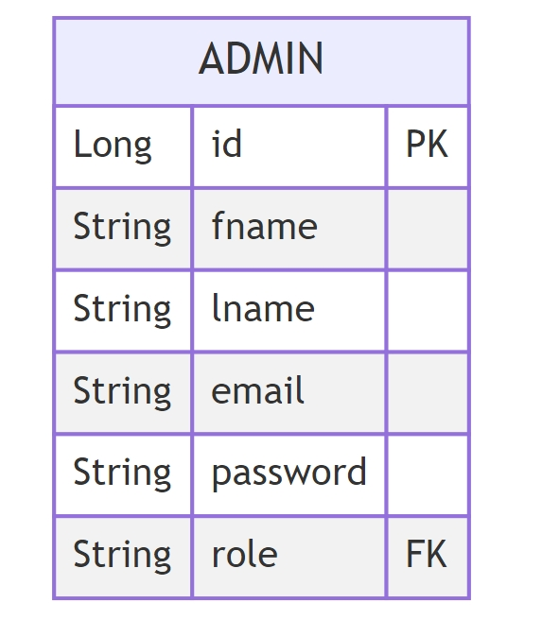
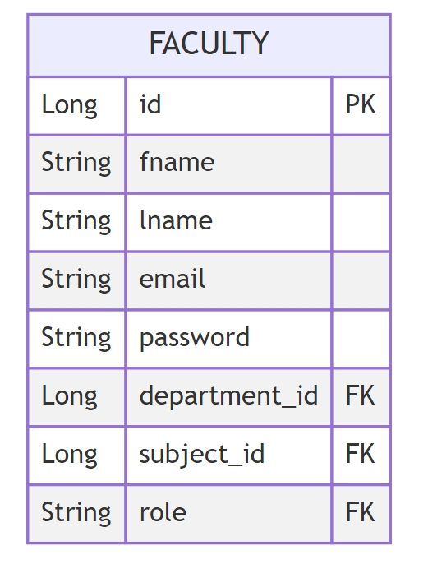
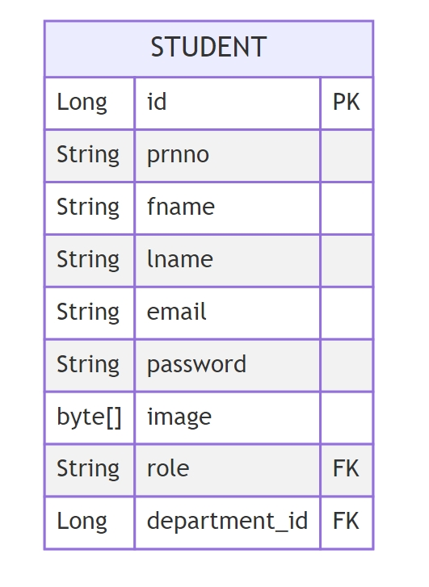
E-R Diagram (Entity Relationship)
has
is taught by
has
has
has
has
has

Slide 8
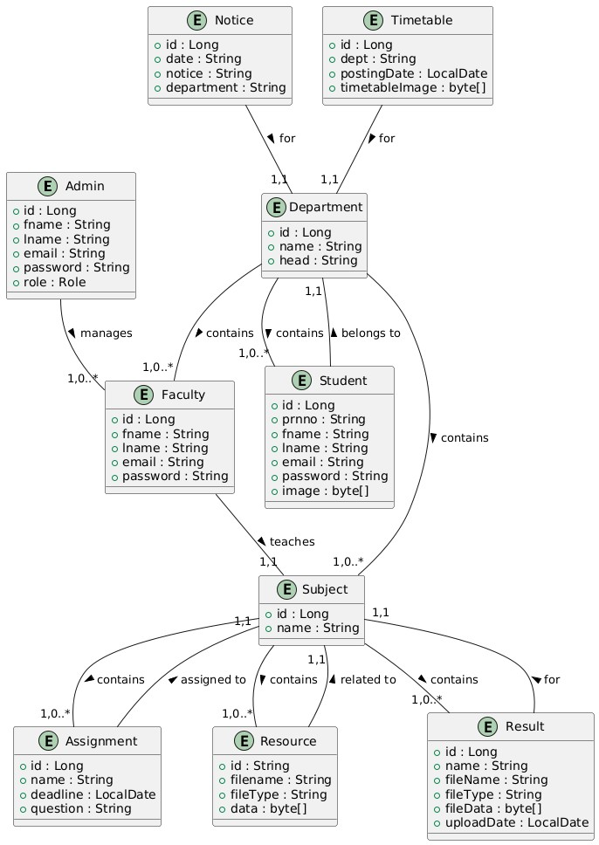
Database Diagram

Slide 9
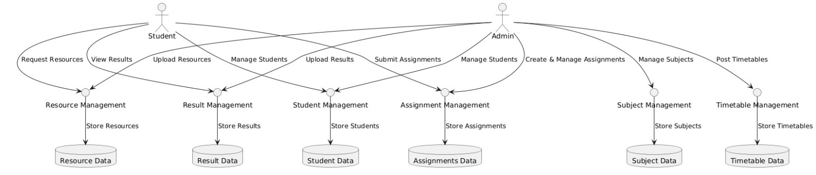
Data Flow Diagram

Slide 10
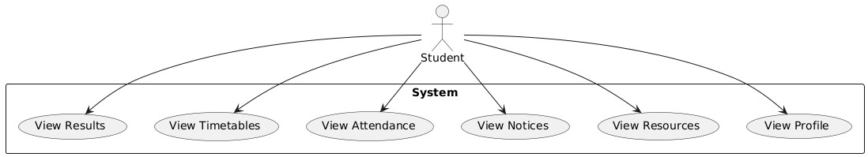
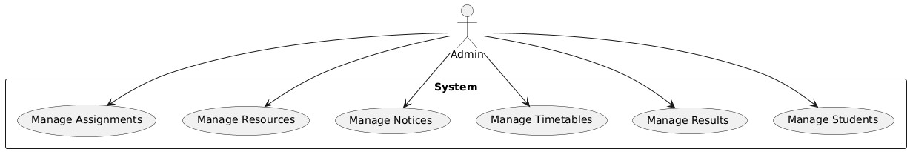
Use Case Diagram
STUDENT
ADMIN

Slide 11
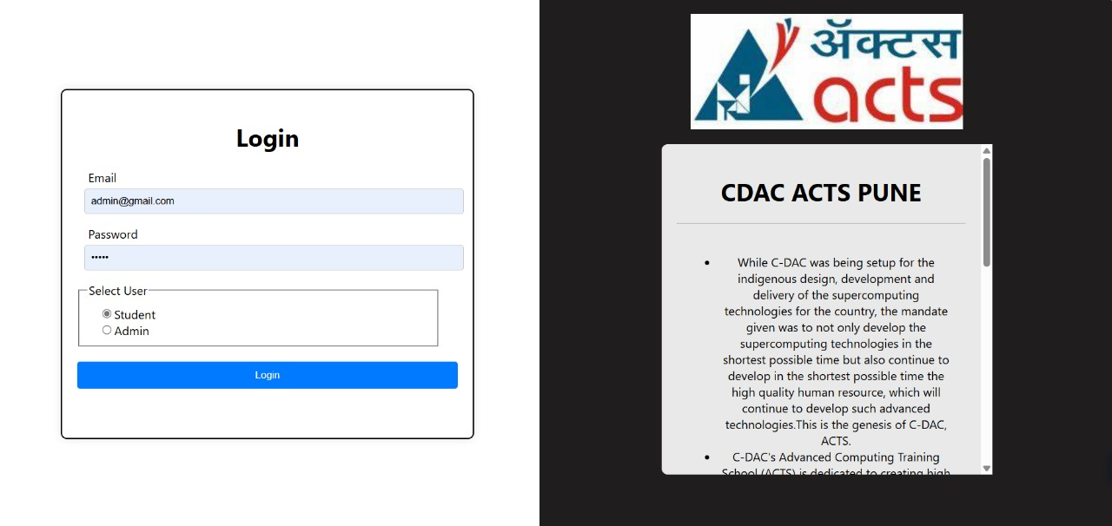
Screenshots
Login – Page

Slide 12
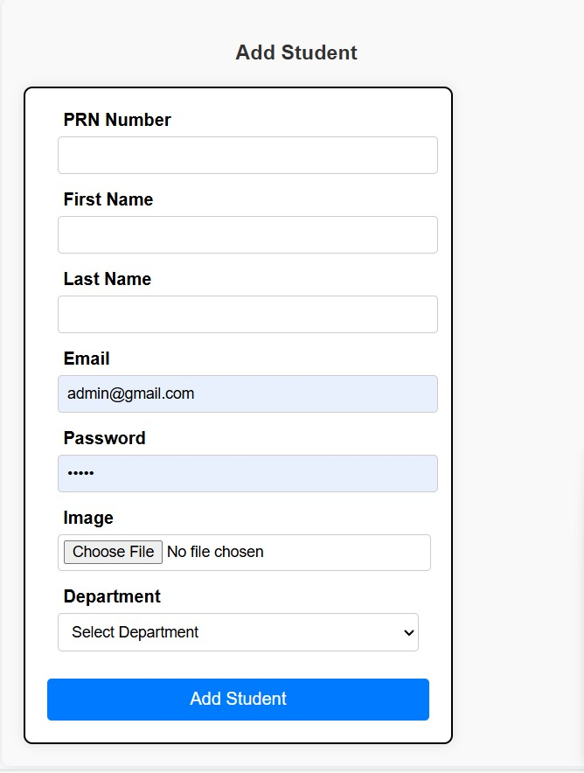
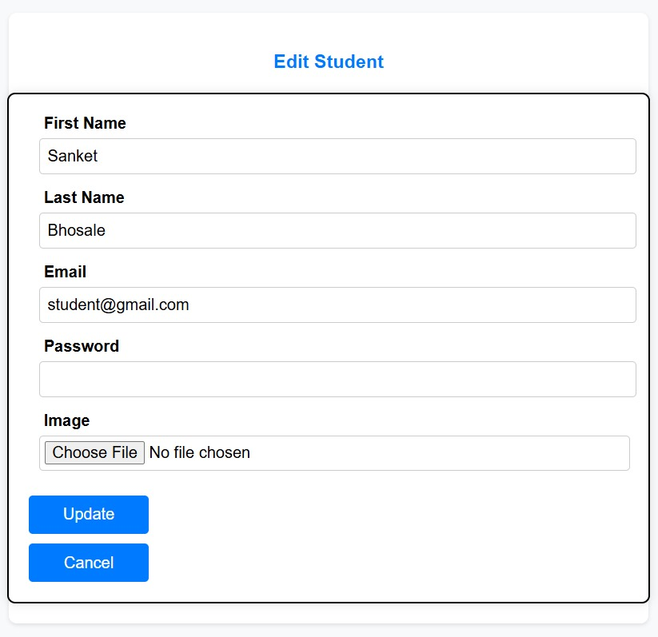
Screenshots
Student Profile

Slide 13
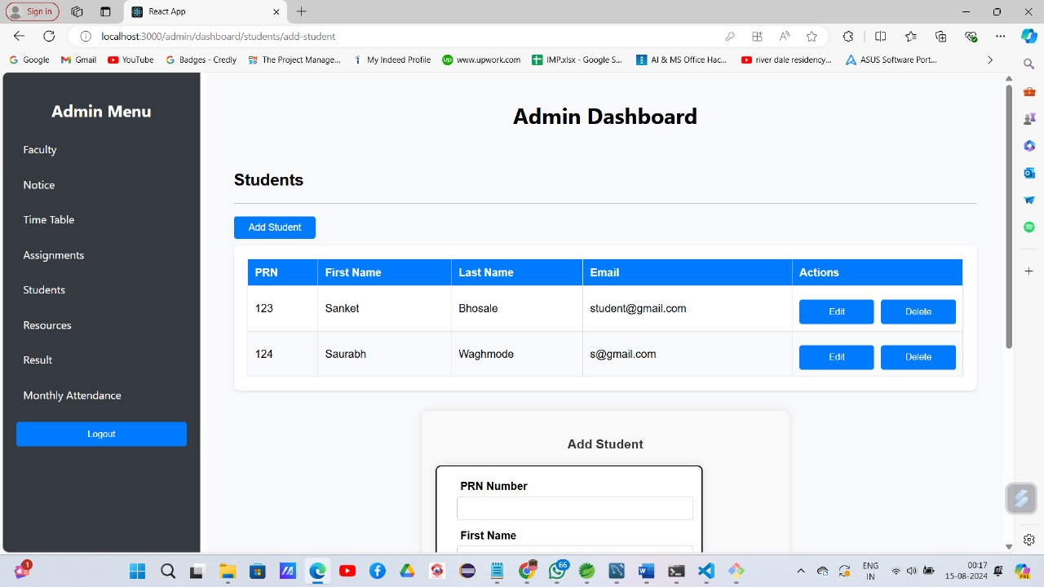
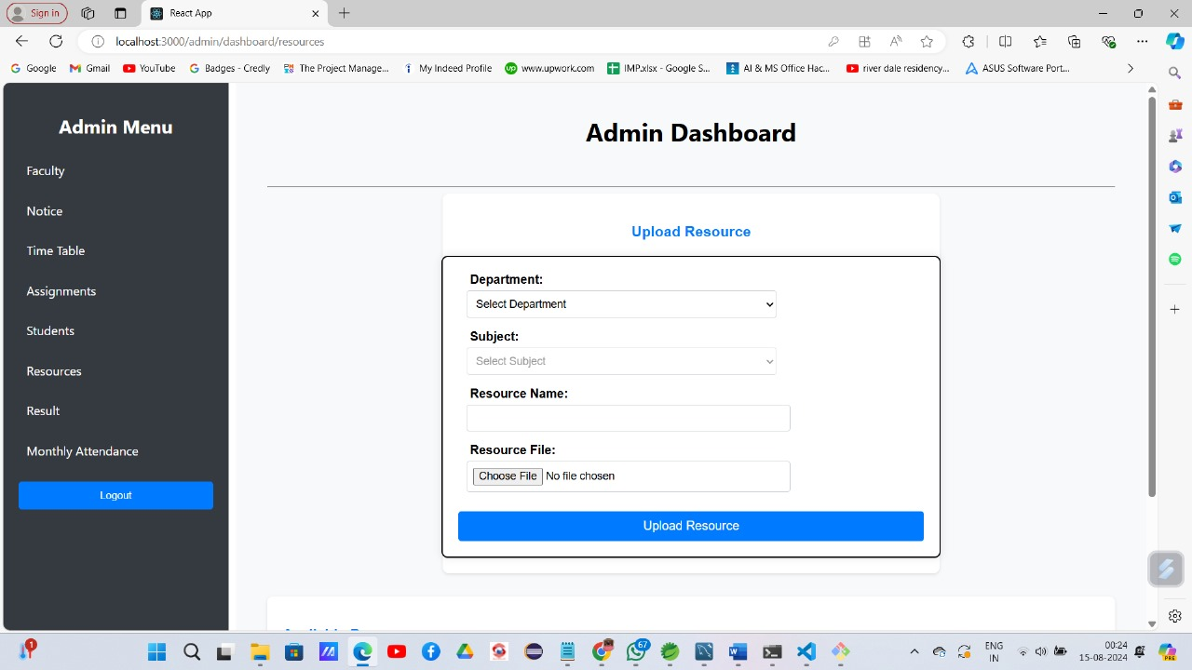
Screenshots
Admin Dashboard

Slide 14
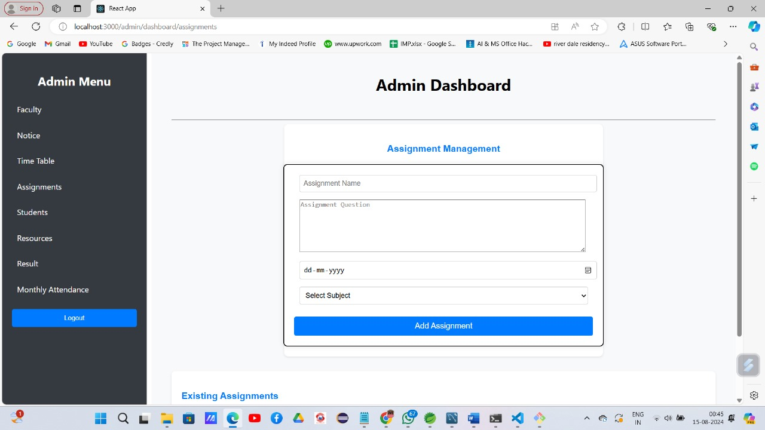
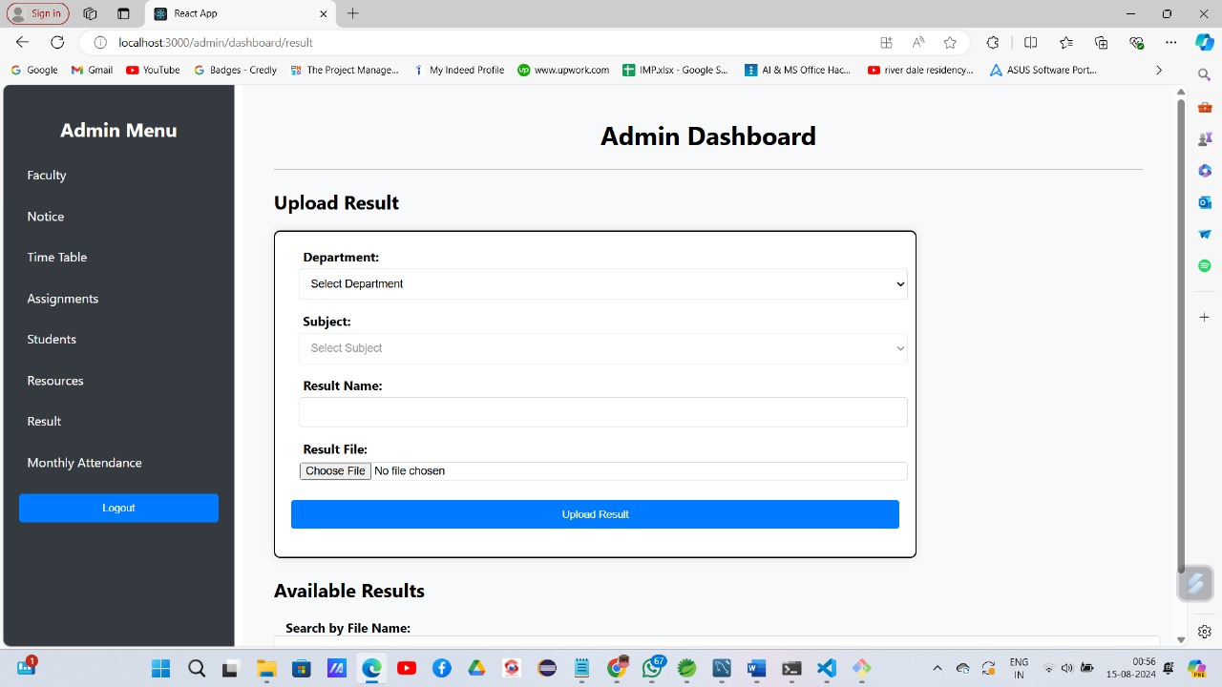
Screenshots
Admin Dashboard

Slide 15
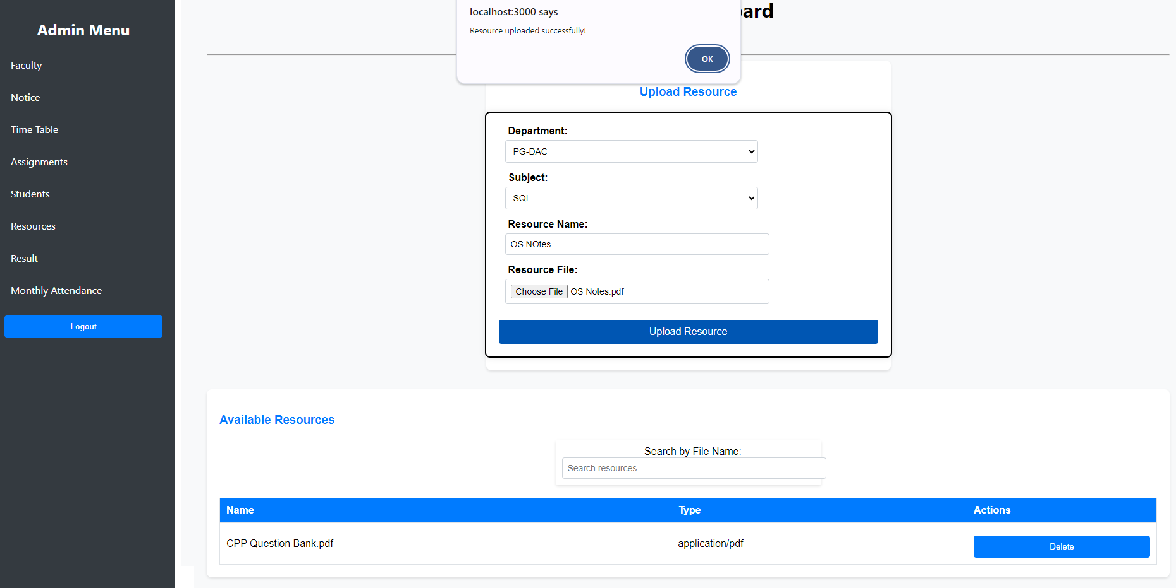
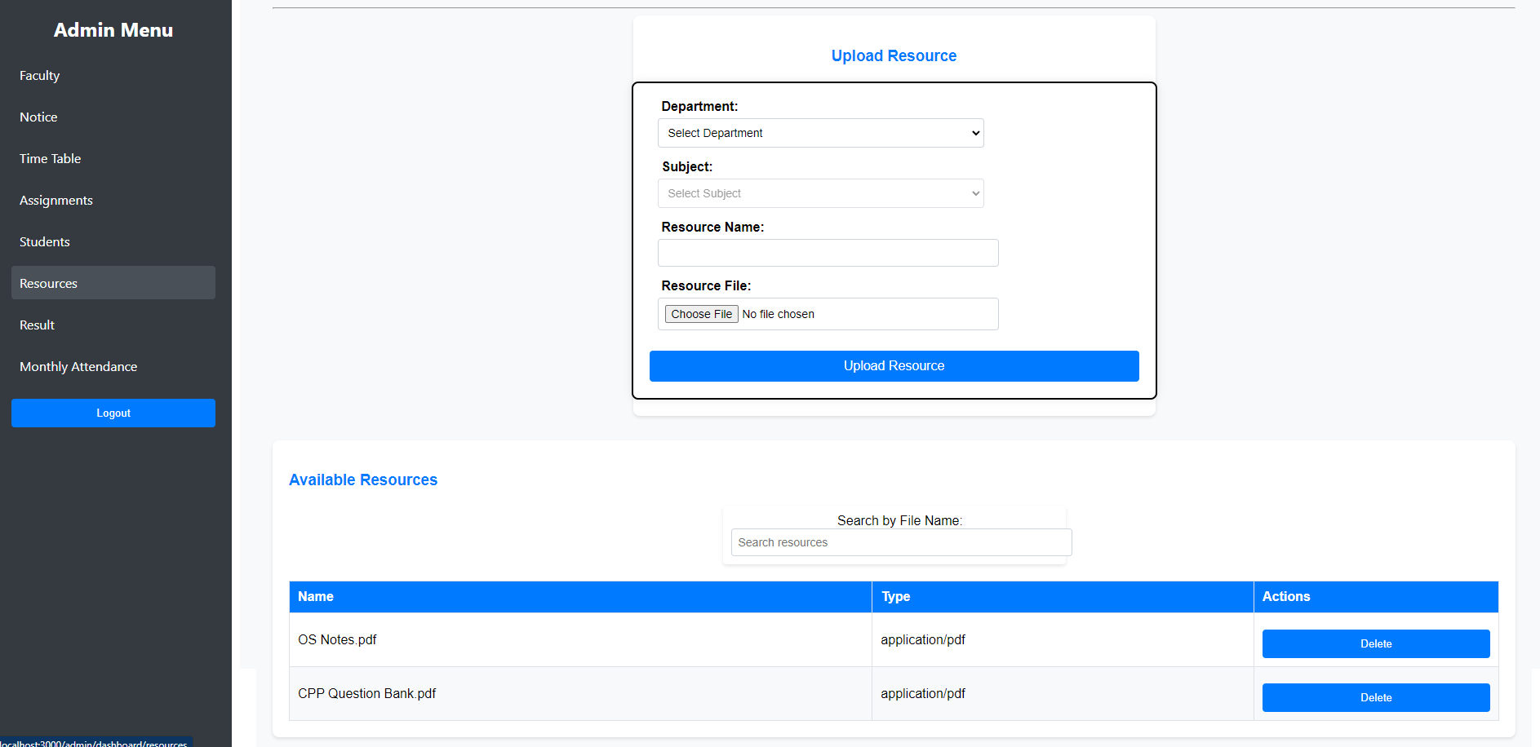
Screenshots
Resources

Slide 16
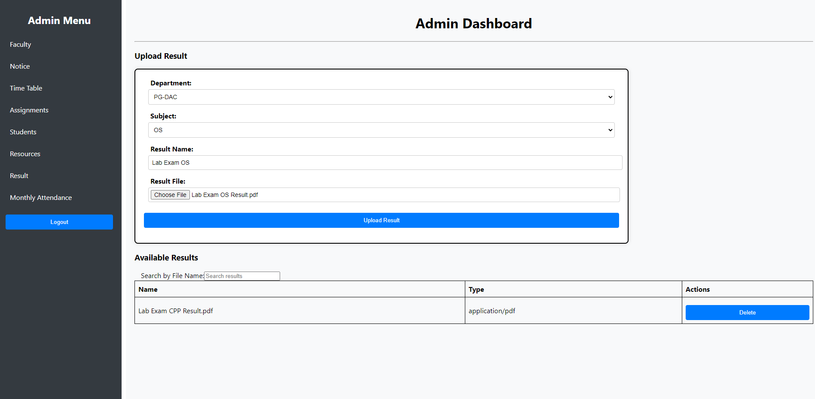
Screenshots
Result

Slide 17
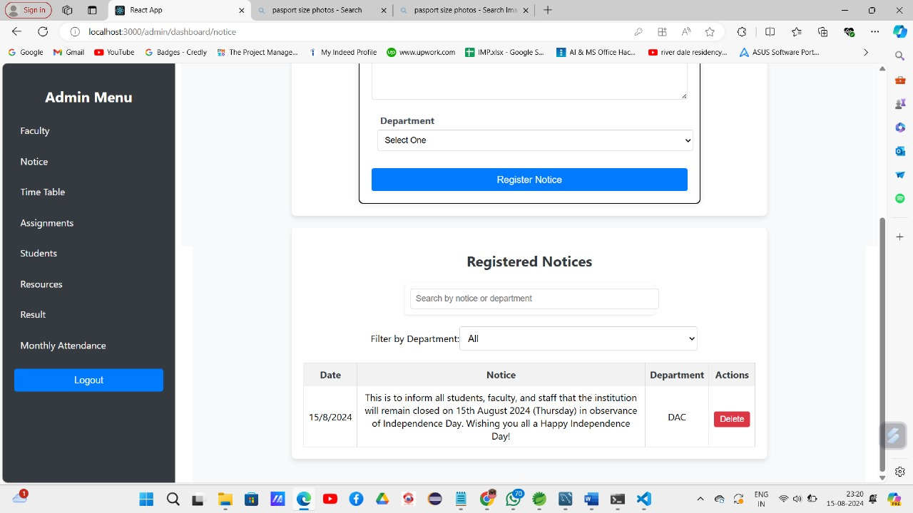
Screenshots
Notice & Assignment Management

Slide 18
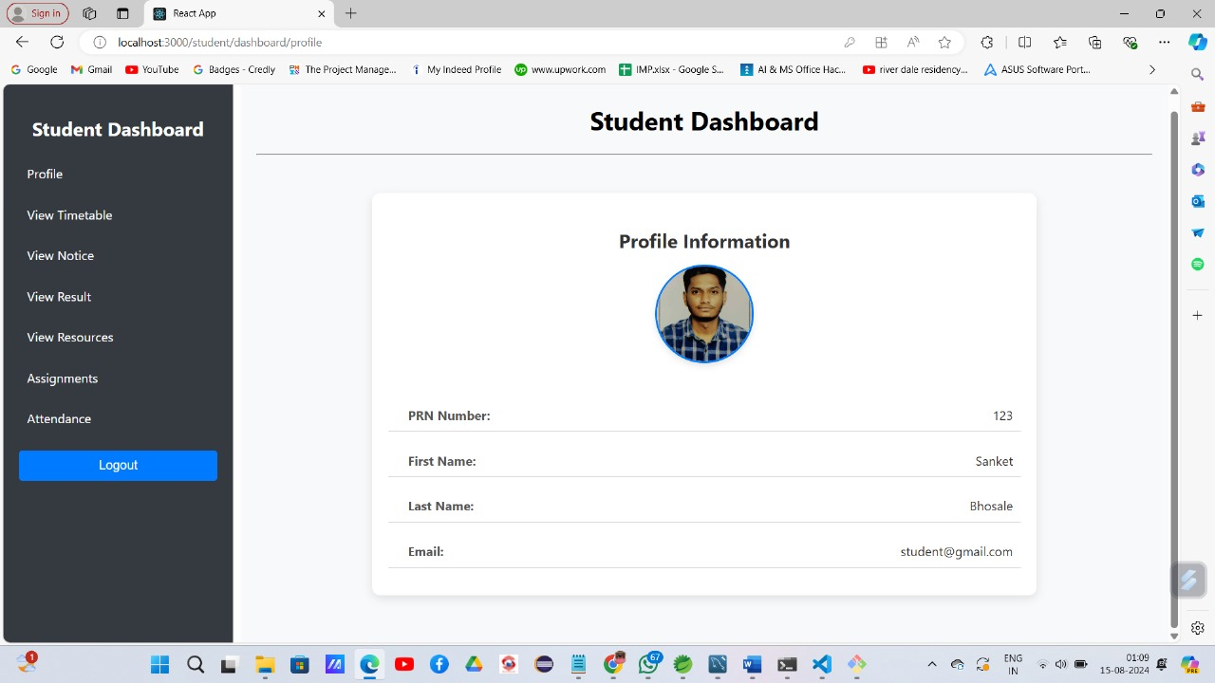
Screenshots
Profile Information

Slide 19
Conclusion
Enhanced Communication: The portal bridges the gap between students and administration, improving real-time communication.
Comprehensive Resource Access: Provides easy access to grades, attendance, timetables, and lecture notes, fostering transparency and efficiency.
Modern Technology Integration: Utilizes React.js, Spring Boot, and MySQL to ensure a robust, scalable, and user-friendly platform.
Empowered Learning Experience: Empowers students with greater control over their academic journey, promoting organization and engagement.
Real-World Impact: Demonstrates our capability in web development and problem-solving, setting a benchmark for future educational technology advancements.

Slide 20
Thank you

